Slide 1

Arrays in c

Slide 2
What is array
An array is a sequential collection of similar data types.
It has fixed size.
Indexing starts from 0.
arr[0]=27
arr[1]=89
arr[2]=43
arr[3]=21
arr[4]=12
Array Declaration:
int arr[5] = {27,89,43,21,12};

Slide 3
Find size of array
int size = sizeof(arr) / sizeof(arr[0]);
This statement is used to calculate the size of the array.

Slide 4
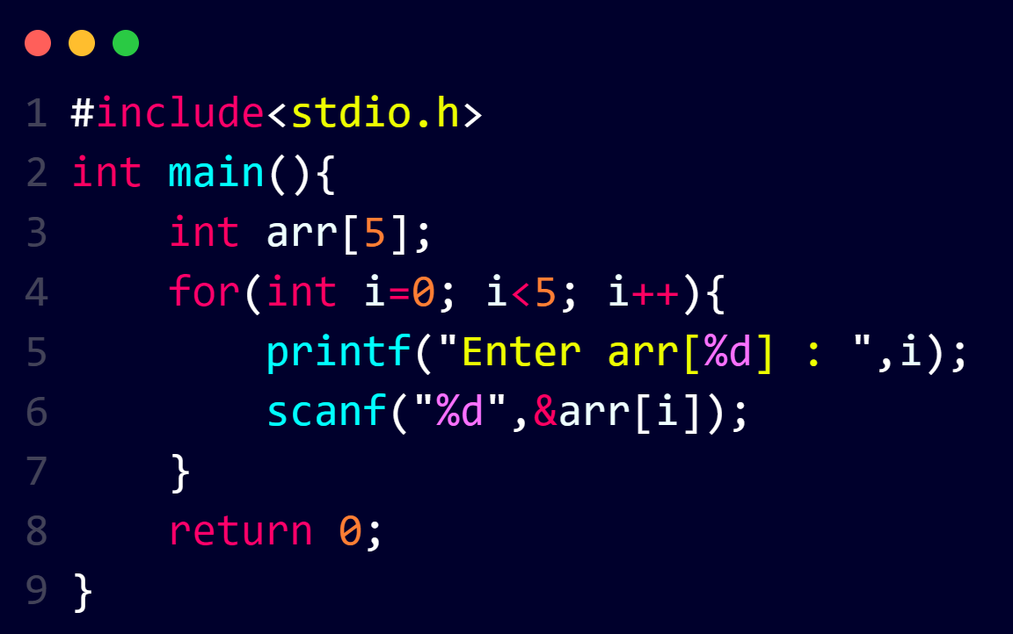
Array Using loop

Slide 5
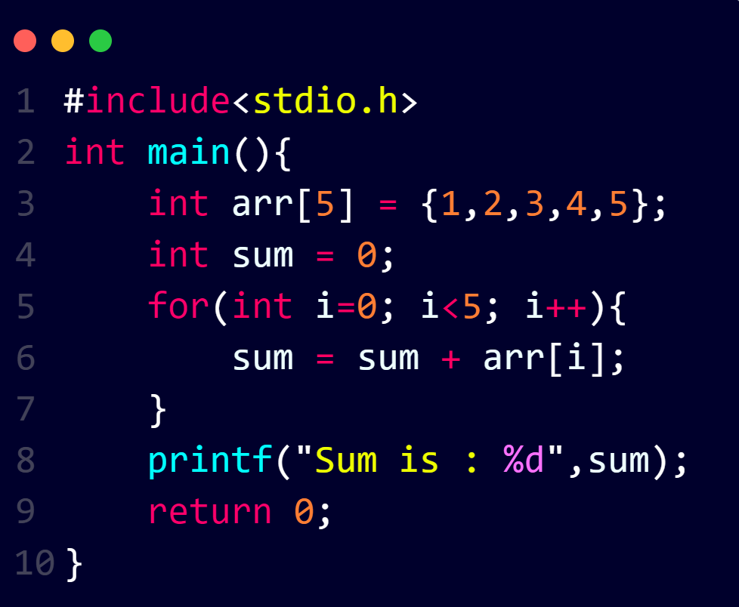
Sum of All Elements

Slide 6
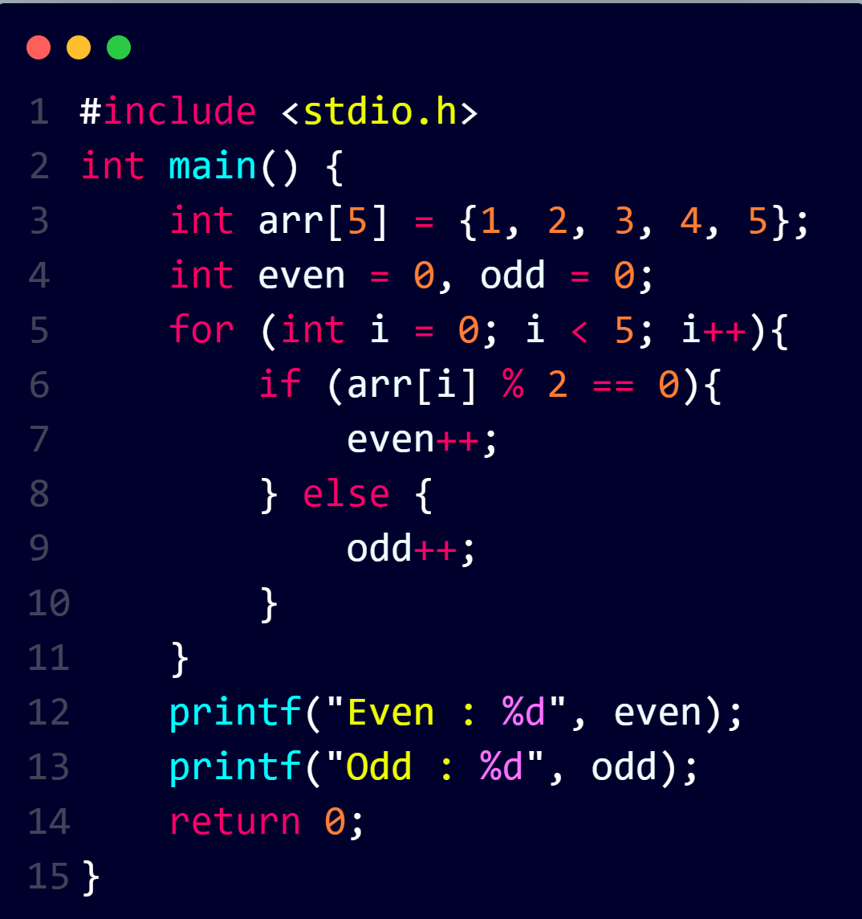
Count odd and even numbers

Slide 7
Find Maximum number in array

Slide 8
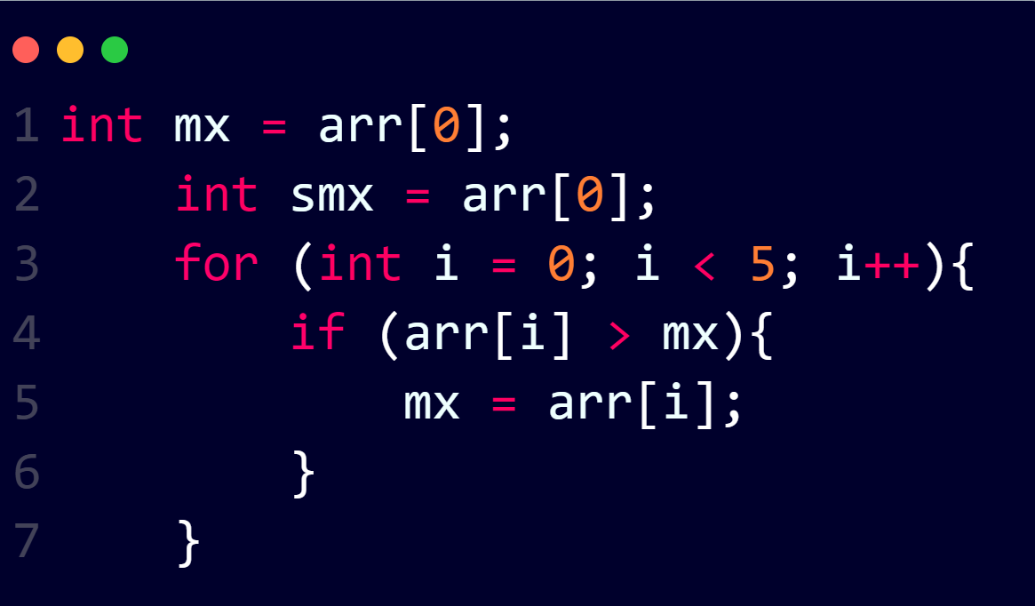
Find Second Maximum Number In Array
First we will find maximum element

Slide 9
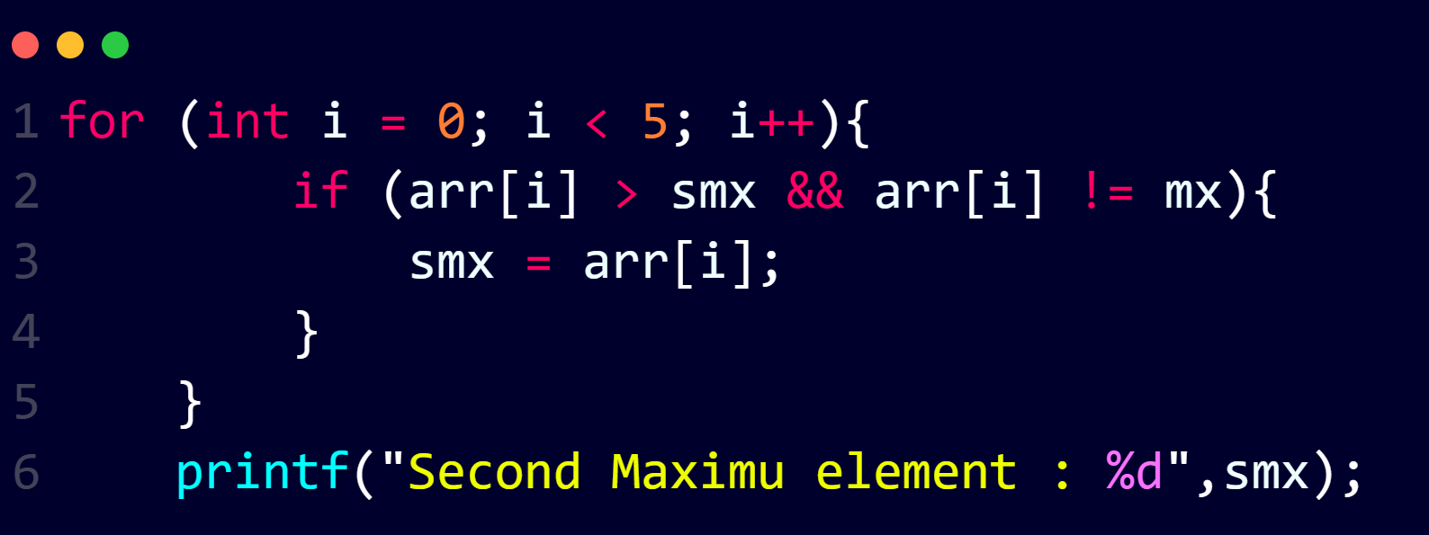
Find Second Maximum Number In Array
Then we will find second maximum element

Slide 10
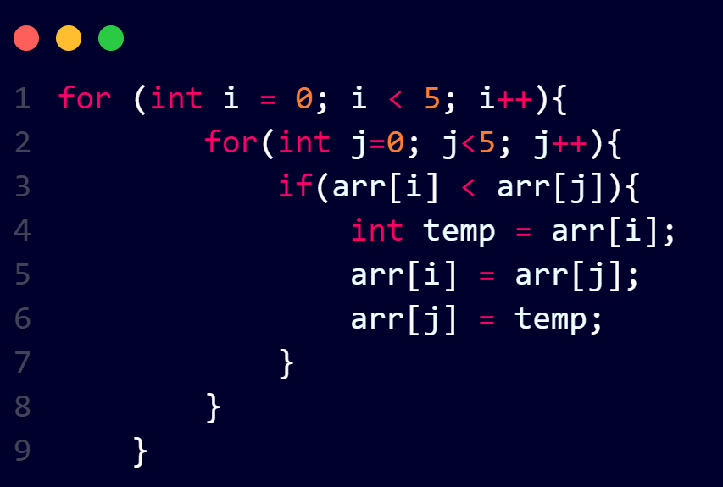
Sort An Array

Slide 11
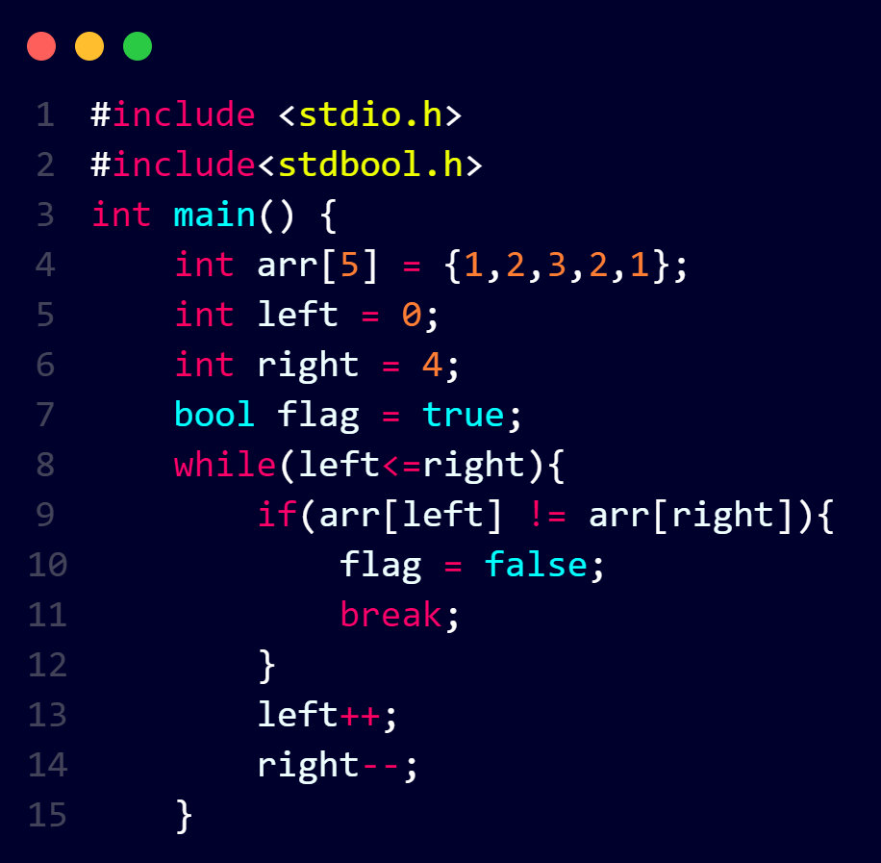
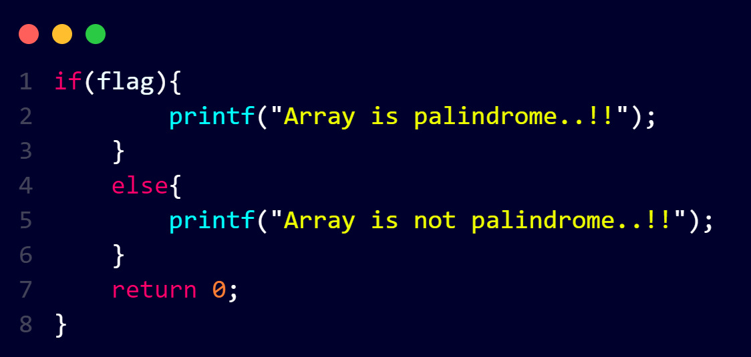
Check For Palindrome Array

Slide 12
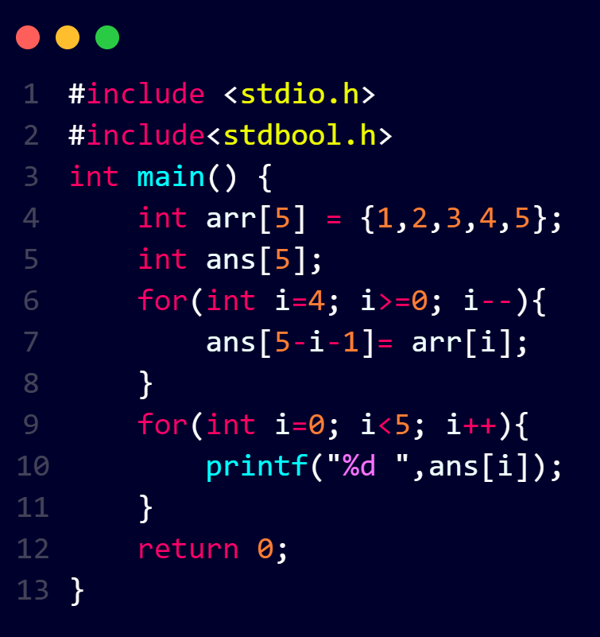
Reverse An Array

